Slide 1

Community Detection in Networks: A Rough Sets and Consensus Clustering Approach
Darian Horacio Grass Boada (dhgrass@unav.es)
Leandro González Montesino
Rubén Armañanzas

Slide 2
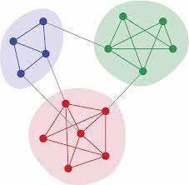
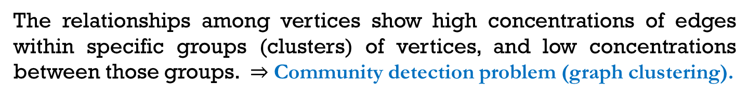
Complex networks analysis
It allows:
the study of how interconnected systems are structured, reveals the underlying patterns governing interactions among elements, and helps assess the influence of individual components within the network.
Examples include: social networks, biological networks (e.g., neural or protein interaction networks), technological systems (e.g., the Internet), and transportation infrastructures.
The relationships among vertices show high concentrations of edges within specific groups (clusters) of vertices, and low concentrations between those groups. $⇒$ Community detection problem (graph clustering).

Slide 3
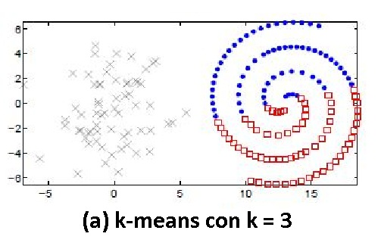
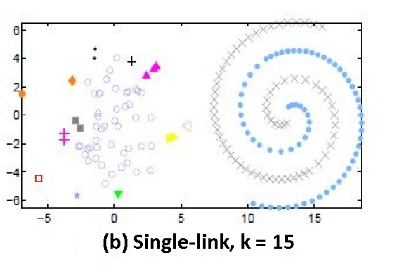
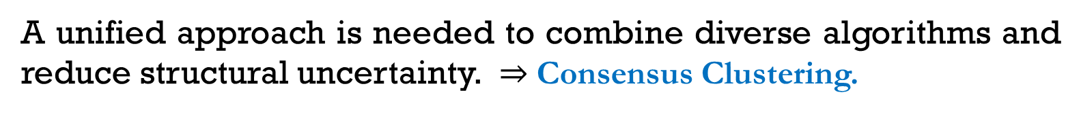


Challenges in Community Detection
Uncertainty in detecting clear community boundaries due to algorithmic variability.
Traditional clustering criteria overlook structural diversity in communities, such as size heterogeneity, non-convexity, or density variations.
$$\min{ \left([m_{1},…, m_{k}]\right)}=\sum_{i=1}^{k}{\sum_{x_{j}∈C_{i}}{{d(x_{j},m_{i})}^{2}}}$$
$$D\left(X,Y\right)= \min_{x∈X,y∈Y}{d(x,y)}$$
A unified approach is needed to combine diverse algorithms and reduce structural uncertainty. $⇒$ Consensus Clustering.

Slide 4
A Rough Set-Based Consensus Framework
1
We introduce Rough Clustering-based Consensus Community Detection (RC-CCD), a community detection framework that combines rough set theory with consensus clustering to improve accuracy and manage uncertainty in complex networks.
Rough set theory identifies:
Core regions: nodes with strong community membership
(lower approximation)
Uncertain regions: boundary nodes with ambiguous affiliation
(upper approximation)
Consensus clustering integrates results from multiple algorithms to produce a more robust community structure.
1
Grass-Boada, D. H., Gonzalez Montesino, L., & Armañanzas, R. “Community Detection in Networks: A Rough Sets and Consensus Clustering Approach”. Applied Soft Computing, accepted for publication. [Online]. Available: https://ssrn.com/abstract=4944660

Slide 5
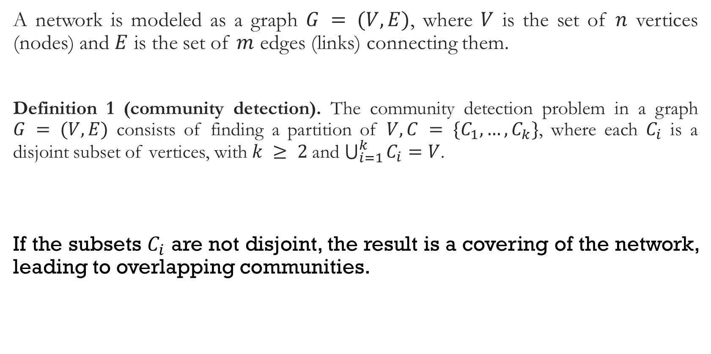
networks as graphs
A network is modeled as a graph $G = (V, E)$, where $V$ is the set of $n$ vertices (nodes) and $E$ is the set of $m$ edges (links) connecting them.
Definition 1 (community detection). The community detection problem in a graph $G = (V, E)$ consists of finding a partition of $V, C = \{C_{1}, …,C_{k}\}$, where each $C_{i}$ is a disjoint subset of vertices, with $k ≥ 2$and $\bigcup_{i=1}^{k}{C_{i}}=V$.
If the subsets $C_{i}$ are not disjoint, the result is a covering of the network, leading to overlapping communities.

Slide 6
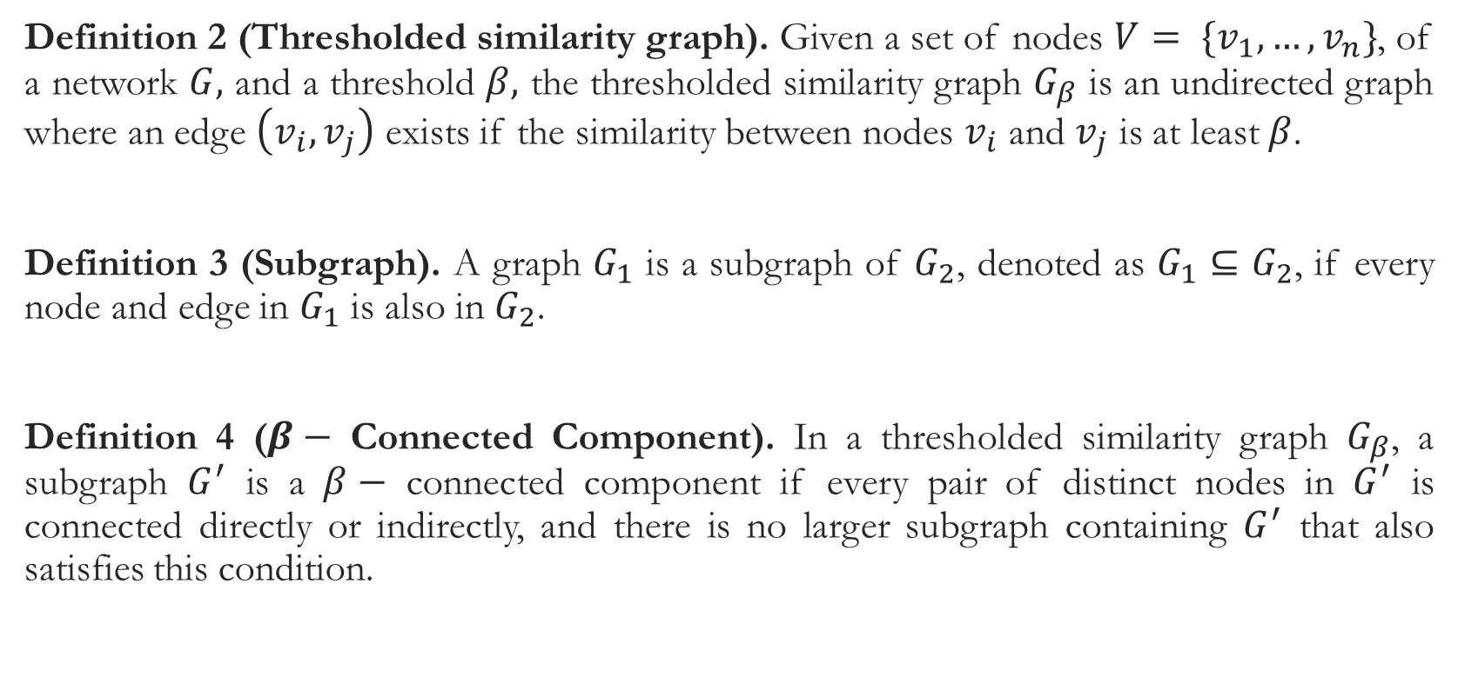
networks as graphs
Definition 2 (Thresholded similarity graph). Given a set of nodes $V= \{v_{1}, …,v_{n}\}$, of a network $G,$ and a threshold $β,$ the thresholded similarity graph $G_{β}$ is an undirected graph where an edge $\left(v_{i}, v_{j}\right)$ exists if the similarity between nodes $v_{i}$ and $v_{j}$ is at least $β$.
Definition 3 (Subgraph). A graph $G_{1}$ is a subgraph of $G_{2}$, denoted as $G_{1}$ $⊆$ $G_{2}$, if every node and edge in $G_{1}$ is also in $G_{2}$.
Definition 4 ($β−$ Connected Component). In a thresholded similarity graph $G_{β}$, a subgraph $G^{′}$ is a $β−$ connected component if every pair of distinct nodes in $G^{′}$ is connected directly or indirectly, and there is no larger subgraph containing $G^{′}$ that also satisfies this condition.

Slide 7
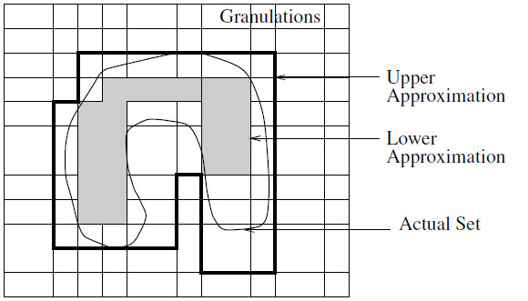
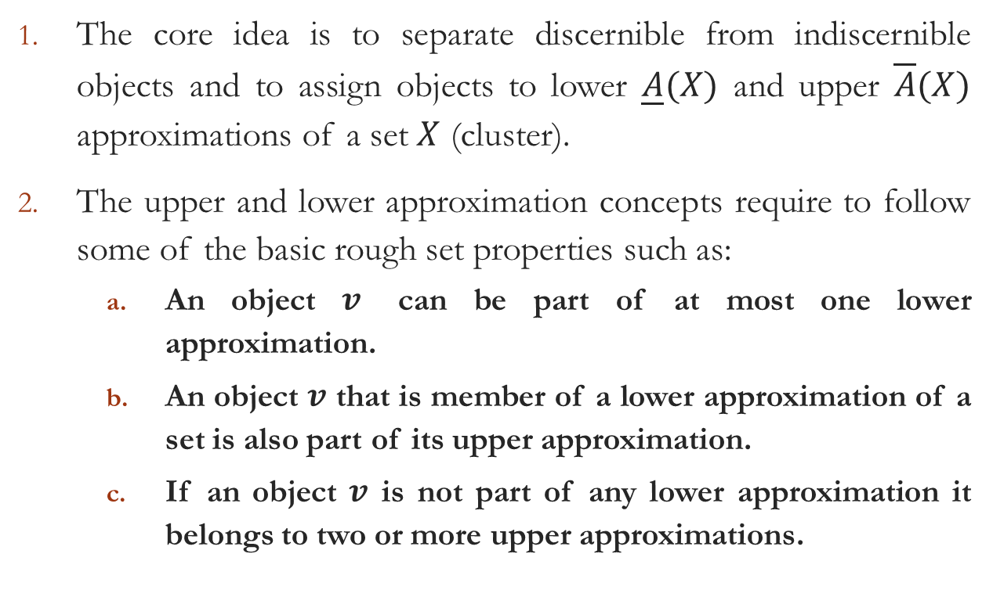


Foundations of Rough Clustering
The core idea is to separate discernible from indiscernible objects and to assign objects to lower $\underline{A}(X)$ and upper $\overline{A}(X)$ approximations of a set $X$ (cluster).
The upper and lower approximation concepts require to follow some of the basic rough set properties such as:
An object $v$ can be part of at most one lower approximation.
An object $v$ that is member of a lower approximation of a set is also part of its upper approximation.
If an object $v$ is not part of any lower approximation it belongs to two or more upper approximations.
$$\underline{A}(X)$$
$$\overline{A}(X)$$

Slide 8
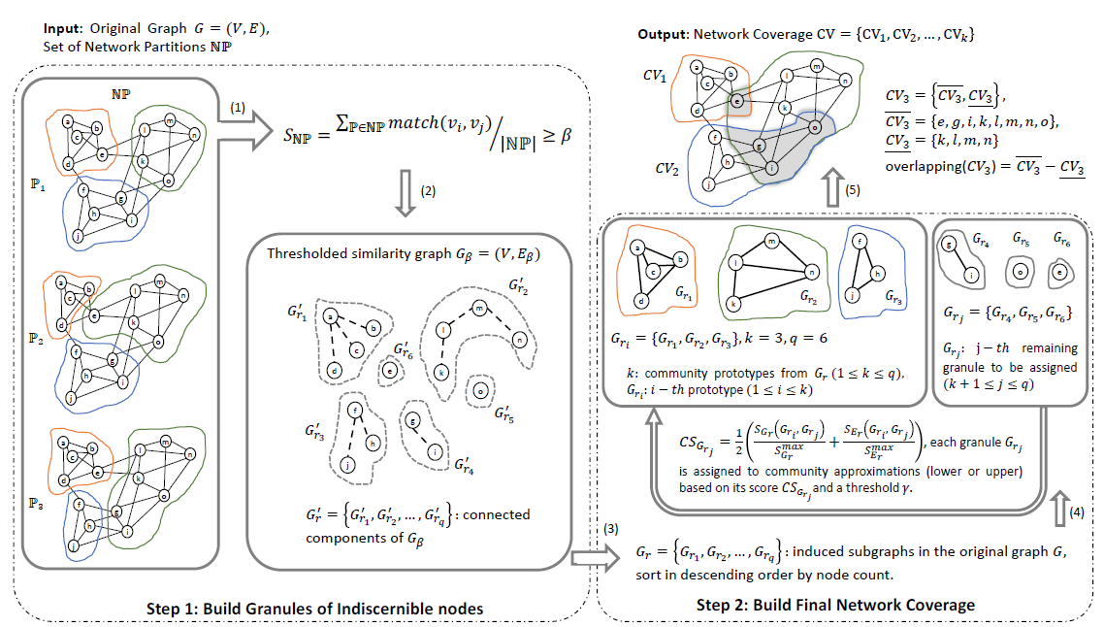
Rough Clustering-based Consensus Community Detection (RC-CCD)
Label Propagation, Greedy Modularity, Infomap, Louvain, or any other community detection algorithm — including multi-objective approaches — can be used.
Figure 1: Summary of the RC-CCD process
(1) Compute the similarity $S_{NP}$ between vertex pairs based on shared communities across partitions $NP, β=0.75$

Slide 9
Rough Clustering-based Consensus Community Detection (RC-CCD)
Label Propagation, Greedy Modularity, Infomap, Louvain, or any other community detection algorithm — including multi-objective approaches — can be used.
Figure 1: Summary of the RC-CCD process
(2) Construct the $β−$ similarity graph and identify its connected components

Slide 10
Rough Clustering-based Consensus Community Detection (RC-CCD)
Label Propagation, Greedy Modularity, Infomap, Louvain, or any other community detection algorithm — including multi-objective approaches — can be used.
Figure 1: Summary of the RC-CCD process
(3) Identify induced subgraphs in the original graph as sets of inseparable nodes

Slide 11
Rough Clustering-based Consensus Community Detection (RC-CCD)
Label Propagation, Greedy Modularity, Infomap, Louvain, or any other community detection algorithm — including multi-objective approaches — can be used.
Figure 1: Summary of the RC-CCD process
(4) Select the largest $k$ granules as community prototypes, and assign remaining granules to lower or upper approximations using the similarity function ${CS}_{G_{r_{j}}}$ and $γ=0.8$ threshold

Slide 12
Rough Clustering-based Consensus Community Detection (RC-CCD)
Label Propagation, Greedy Modularity, Infomap, Louvain, or any other community detection algorithm — including multi-objective approaches — can be used.
Figure 1: Summary of the RC-CCD process
(5) Output communities with core and boundary members

Slide 13
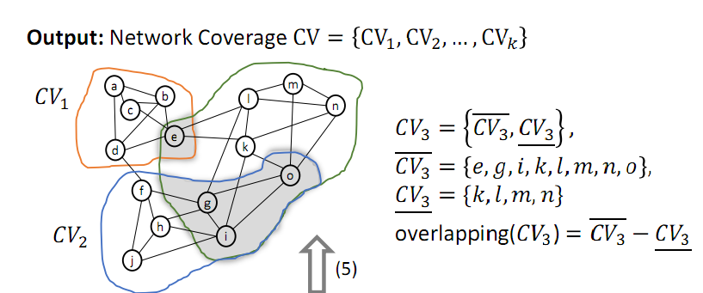
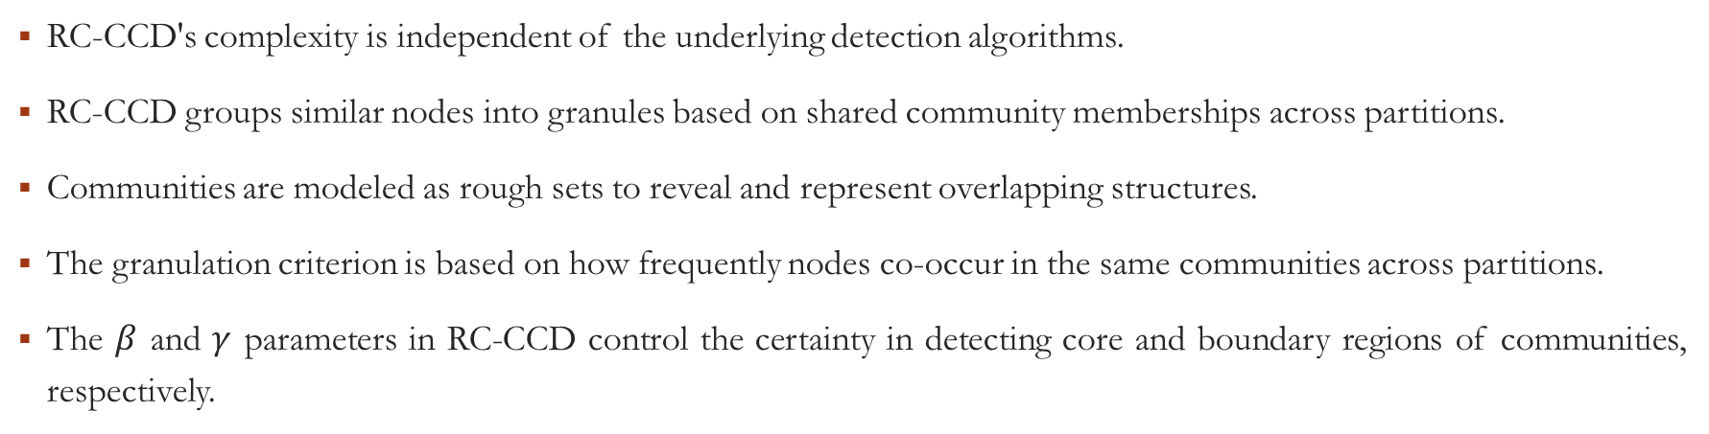
Foundations of RC-CCD
RC-CCD's complexity is independent of the underlying detection algorithms.
RC-CCD groups similar nodes into granules based on shared community memberships across partitions.
Communities are modeled as rough sets to reveal and represent overlapping structures.
The granulation criterion is based on how frequently nodes co-occur in the same communities across partitions.
The $β$ and $γ$ parameters in RC-CCD control the certainty in detecting core and boundary regions of communities, respectively.

Slide 14
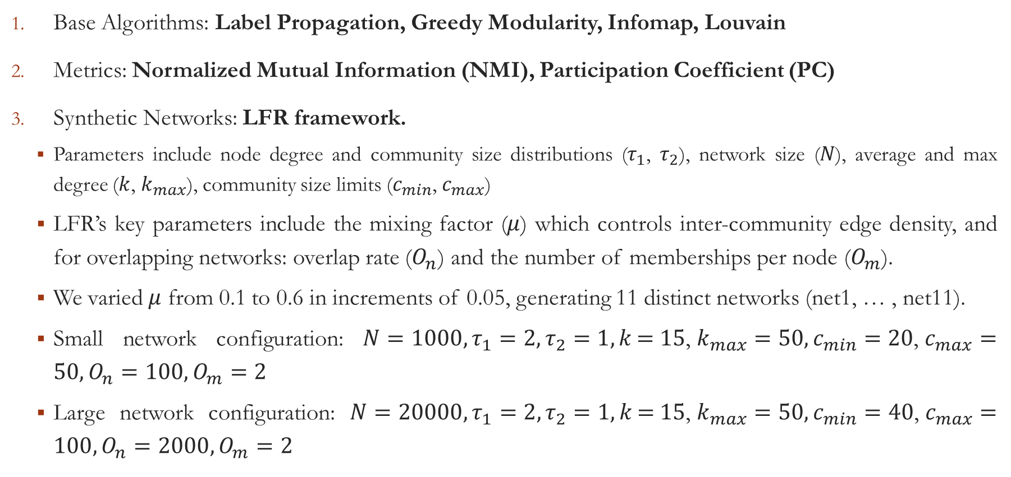
Experimental Setup
Base Algorithms: Label Propagation, Greedy Modularity, Infomap, Louvain
Metrics: Normalized Mutual Information (NMI), Participation Coefficient (PC)
Synthetic Networks: LFR framework.
Parameters include node degree and community size distributions ($τ_{1}$, $τ_{2}$), network size ($N$), average and max degree ($k$, $k_{max}$), community size limits ($c_{min}$, $c_{max}$)
LFR’s key parameters include the mixing factor ($μ$) which controls inter-community edge density, and for overlapping networks: overlap rate ($O_{n}$) and the number of memberships per node ($O_{m}$).
We varied $μ$ from 0.1 to 0.6 in increments of 0.05, generating 11 distinct networks (net1, … , net11).
Small network configuration: $N=1000, τ_{1}=2, τ_{2}=1,k\text{ = 15}\text{, }k_{max}=50,c_{min}=20\text{, }c_{max}=50,O_{n}=100,O_{m}=2$
Large network configuration: $N=20000, τ_{1}=2, τ_{2}=1,k\text{ = 15}\text{, }k_{max}=50,c_{min}=40\text{, }c_{max}=100,O_{n}=2000,O_{m}=2$

Slide 15
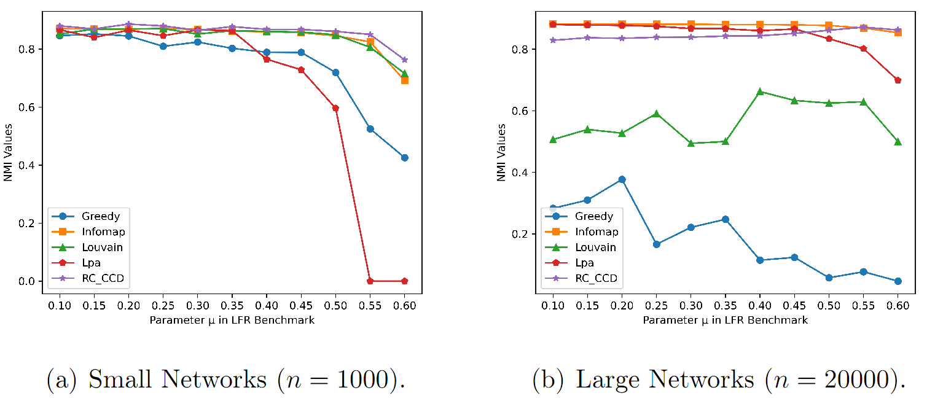
Result: NMI quality measure
RC-CCD achieves high NMI in small networks, outperforming LPA and Greedy, and matching Infomap and Louvain.
In large networks, RC-CCD remains competitive or superior, especially in complex cases like net10 and net11.
Stable and accurate across all sizes, RC-CCD stands out for its robustness and independence from base algorithms.

Slide 16
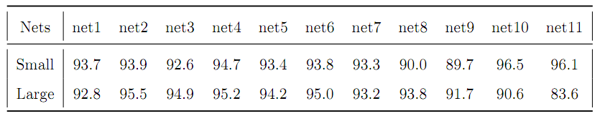
Result: Cores Accuracy Evaluation
RC-CCD achieves over 90% accuracy in identifying core regions (lower approximations) across both small and large networks.
Results are consistent with ground-truth distributions and remain stable across different network complexities.

Slide 17
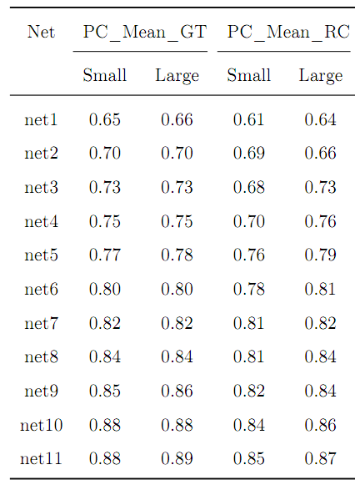
Result: Evaluation of Community Overlap
RC-CCD shows slightly lower PC values than ground truth in simpler networks (e.g., 0.61 vs. 0.65 in net1), but these values consistently converge as network complexity increases, reaching near-ground-truth levels (e.g., 0.87 vs. 0.89 in net11).
This trend is consistent across both small and large networks, confirming the method’s adaptability.

Slide 18
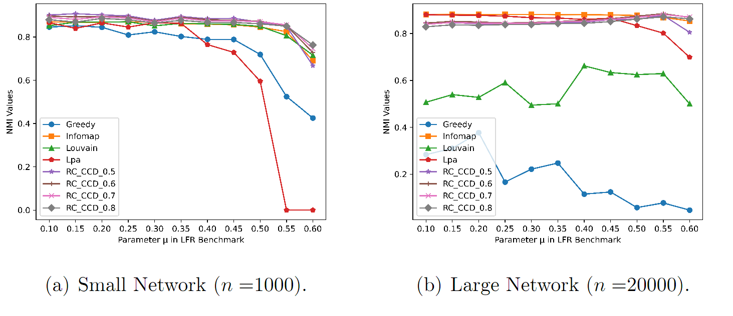
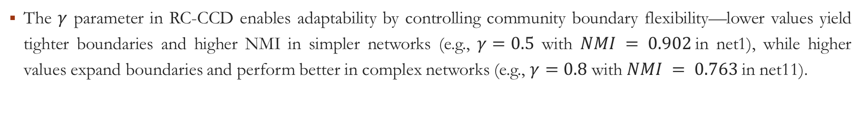
Result: Boundary Structure Under Different Upper Approximation Scales
The $γ$ parameter in RC-CCD enables adaptability by controlling community boundary flexibility—lower values yield tighter boundaries and higher NMI in simpler networks (e.g., $γ=0.5$ with $NMI = 0.902$in net1), while higher values expand boundaries and perform better in complex networks (e.g., $γ=0.8$ with $NMI = 0.763$in net11).

Slide 19
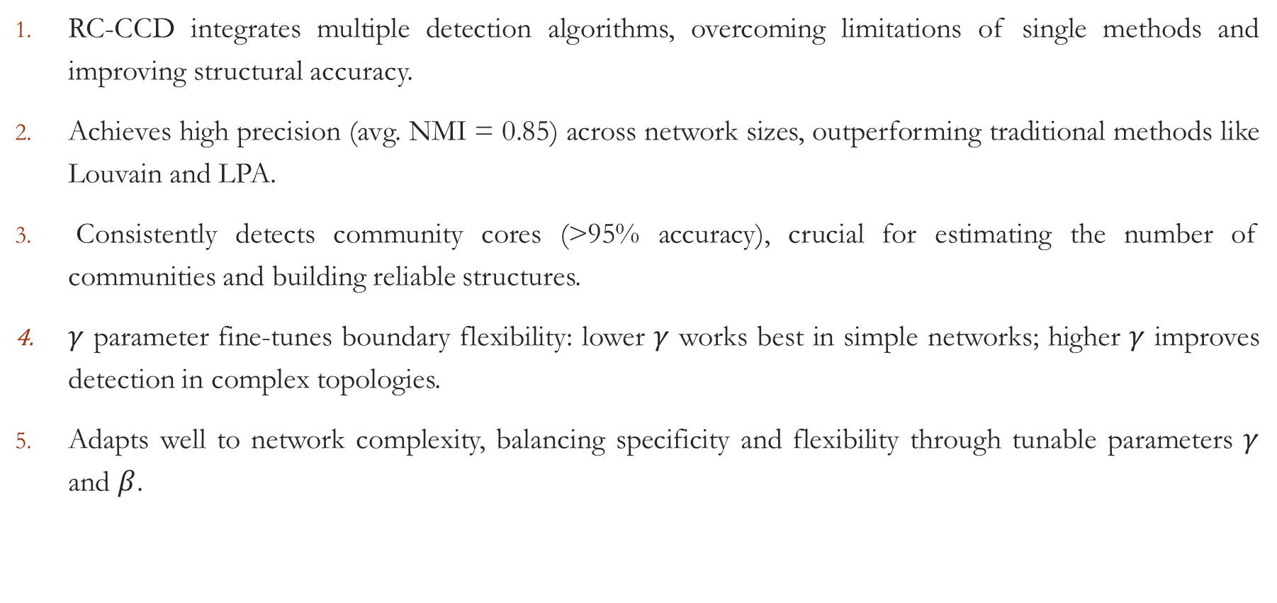
Discussion – Key Points
RC-CCD integrates multiple detection algorithms, overcoming limitations of single methods and improving structural accuracy.
Achieves high precision (avg. NMI = 0.85) across network sizes, outperforming traditional methods like Louvain and LPA.
Consistently detects community cores (>95% accuracy), crucial for estimating the number of communities and building reliable structures.
$γ$ parameter fine-tunes boundary flexibility: lower $γ$ works best in simple networks; higher $γ$ improves detection in complex topologies.
Adapts well to network complexity, balancing specificity and flexibility through tunable parameters $γ$ and $β$.

Slide 20
Community Detection in Networks: A Rough Sets and Consensus Clustering Approach
Darian Horacio Grass Boada (dhgrass@unav.es)
Leandro González Montesino
Rubén Armañanzas

